Slide 1


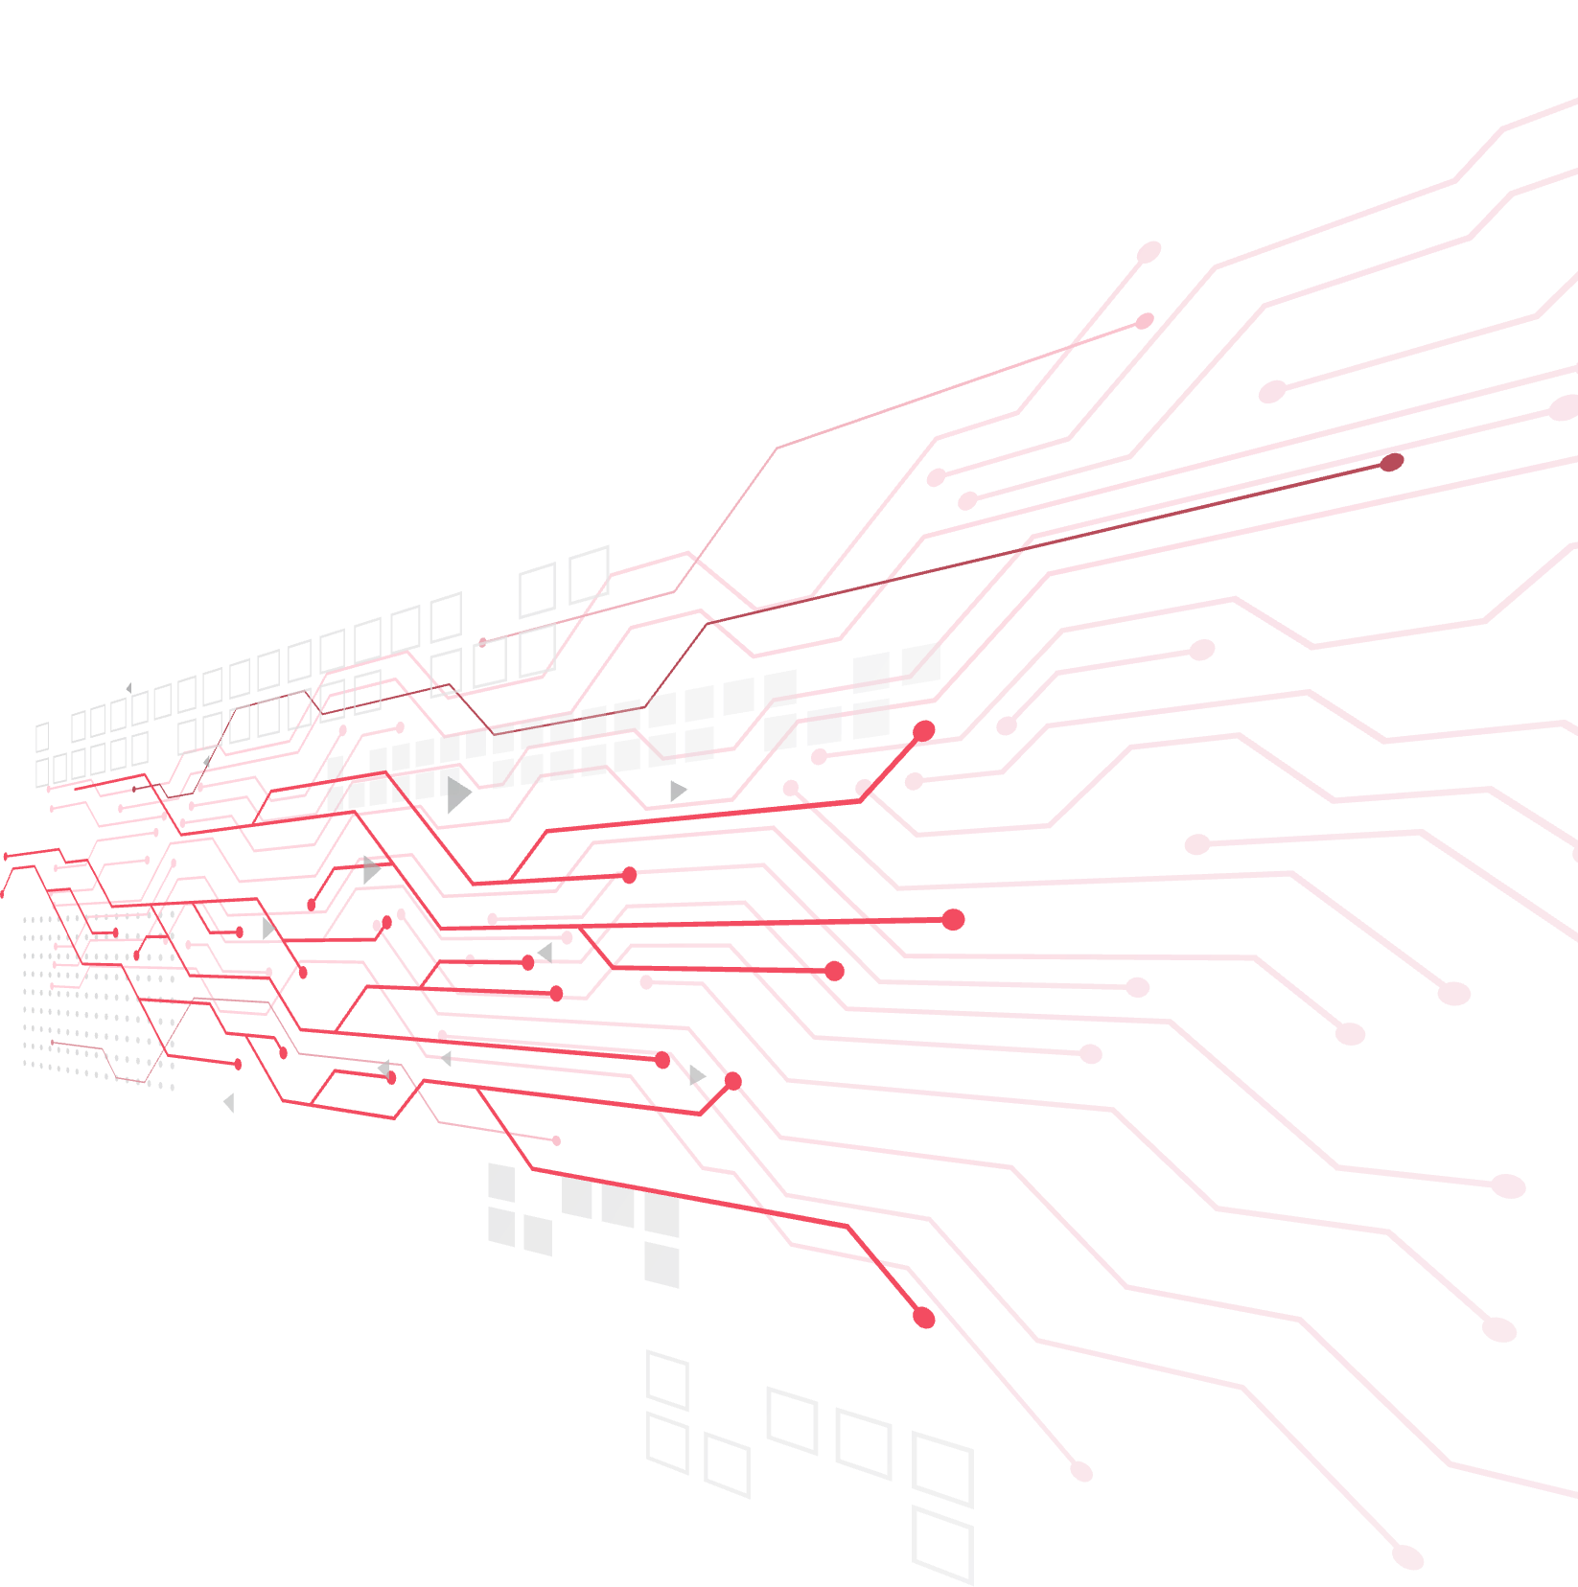

BANK ACCOUNT OPENING FRAUD DETECTION

Slide 2
Appendix
Introduction
Business Understanding
Data Understanding
Data Preparation
Model
Deployment

Slide 3
01- Introduction
Notes:
Note: Please after inserting your picture, “Right Click” on the picture and “Send it to Back” to get the “Gradient” effect.

Slide 4
Introduction
What is Account Opening Fraud?
New Account Fraud is a form of identity fraud
It involves a fraudster applying for a new account in someone’s name for a
service using fake identities
Obtain credit or make purchases using the stolen identity
=> Financial damage
About the dataset
Dataset is provided by feedzai - the market leader in fighting financial crime with AI
Contains 1 million rows, 31 features

Slide 5
02- Business
Understanding
Notes:
Note: Please after inserting your picture, “Right Click” on the picture and “Send it to Back” to get the “Gradient” effect.

Slide 6
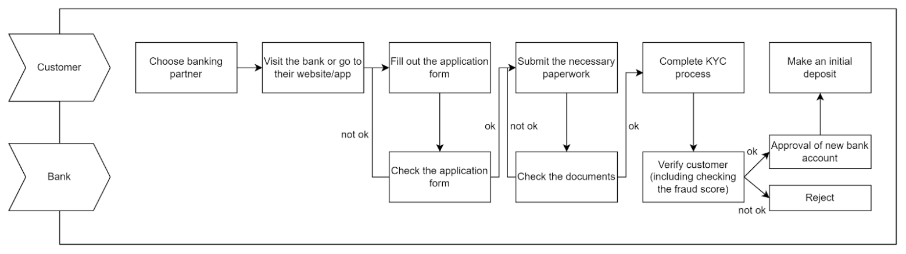
Business term | Detail | Related features
Fraudulent bank account application | A positive value (fraud_bool=1) represents a fraudulent bank account application. A negative value (fraud_bool=0) represents a legitimate bank account application. Fraudulent bank account application is the process of a fraudster signing up for an account, such as a bank account, using a false identity. That false identity may be a product of them creating a completely fake identity (identity fraud), logging in using another user’s login credentials without authorization (account takeover) or using a combination of fake and real identity information (identity manipulation). | Label: fraud_bool
Required information/documents to open a new bank account: | Identification: Passport w/photo Driver’s License Social Security Card Birth Certificate
 | Personal information: Date of birth Phone number Email Physical address Income Employment status | income name_email_similarity customer_age date_of_birth_distinct_emails_4w employment_status email_is_free housing_status phone_home_valid phone_mobile_valid
 | Proof of address: can be one of the following documents: Water, electricity, gas, telephone, or Internet bill Credit card bill or statement Bank statement Bank reference letter Mortgage statement or contract Letter issued by a public authority (e.g., a courthouse) Company pay slip Car or home insurance policy Car registration Authorized change of address form Letter of employment Official letter from an educational institution Municipality bill or government tax letter Driver’s license Residence permit Lease agreement for your residence | prev_address_months_count current_address_months_count
 | Other information | bank_months_count has_other_cards
Information related to the process of opening a bank account | Credit risk score Initial deposit Customer's device information ... | credit_risk_score days_since_request intended_balcon_amount payment_type proposed_credit_limit foreign_request source session_length_in_minutes device_os keep_alive_session device_distinct_emails_8w device_fraud_count
Information related to bank | Number of applications made in the selected bank | zip_count_4w velocity_6h velocity_24h velocity_4w bank_branch_count_8w
Process of opening a bank account
Business Understanding

Slide 7
03- Data Understanding
Notes:
Note: Please after inserting your picture, “Right Click” on the picture and “Send it to Back” to get the “Gradient” effect.

Slide 8
Data Undestanding
No. | Variable | Definition/Descriptions | Data Type | Values | Values
0 | fraud_bool | Fraud label (1 if fraud, 0 if legit) | int64 | 0; 1 | [-1, 31]
1 | income | Annual income of the applicant in quantiles | float64 | [0, 1] | 0; 1
2 | name_email_similarity | Metric of similarity between email and applicant’s name. Higher values represent higher similarity. | float64 | [0, 1] | [200, 2000]
3 | prev_address_months_count | Number of months in previous registered address of the applicant, i.e., the applicant’s previous residence, if applicable (-1 is a missing value) | int64 | [-1, 380] | 0; 1
4 | payment_type | Credit payment plan type: 5 possible (annonymized) values | int64 | [-1, 406] | INTERNET, TELEAPP
5 | customer_age | Applicant’s age in bins per decade (e.g, 20-29 is represented as 20) | int64 | [10, 90] | [-1, 107]
6 | days_since_request | Number of days passed since application was done | float64 | [0, 78] | Windows, Macintox, Linux, X11, other
7 | intended_balcon_amount | Initial transferred amount for application | float64 | [-1, 108] | 0; 1
8 | credit_risk_score | Internal score of application risk | Int64 | [-176, 387] | [0, 3]
9 | session_length_in_minutes | Length of user session in banking website in minutes. | float64 | [-1, 107] | [0, 1]
10 | has_other_cards | If applicant has other cards from the same banking company | int64 | 0; 1 | [0, 7]
Data Understanding Table

Slide 9
Data Quality Assessment
Features | Data type | No, unique values | Distribution |  |  |  |  | % missing values | % outliers
 |  |  | min | p25 | p50 | p75 | max
income | float64 | 9 | 0,10 | 0,30 | 0,60 | 0,80 | 0,90
name_email_similarity | float64 | 998687 | 0,00 | 0,21 | 0,49 | 0,75 | 1,00
prev_address_months_count | int64 | 374 | -1,00 | -1,00 | -1,00 | -1,00 | 399,00 | 76,2%
payment_type | object | 5
customer_age | int64 | 9 | 10,00 | 30,00 | 50,00 | 50,00 | 90,00 |  | 0,4%
days_since_request | float64 | 988853 | 0,00 | 0,01 | 0,02 | 0,03 | 76,58 |  | 9,1%
intended_balcon_amount | float64 | 994836 | -15,74 | -1,18 | -0,83 | -0,07 | 112,70 |  | 24,7%
credit_risk_score | int64 | 545 | -177,00 | 90,00 | 130,00 | 188,00 | 388,00 |  | 0,7%
session_length_in_minutes | float64 | 994951 | -1,00 | 3,15 | 5,25 | 9,37 | 85,57 | 0,2% | 7,4%
has_other_cards | int64 | 2 | 0,00 | 0,00 | 0,00 | 0,00 | 1,00
Data Quality Assessment

Slide 10
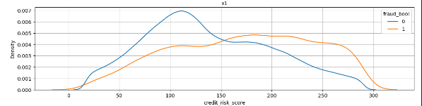
EDA
Từ biểu đồ phân phối của biến "credit_risk_score" về điểm số rủi ro tín dụng, khách hàng có điểm số càng cao thì càng có khả năng là fraud.
Khách hàng có điểm số rủi ro tín dụng trong lớn hơn 150 có tỉ lệ fraud lớn hơn.

Slide 11
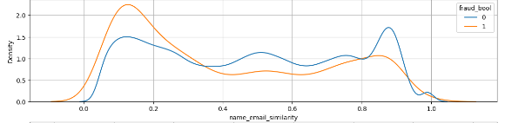
EDA
Biểu đồ phân phối của biến "name_email_similarity" về sự giống nhau giữa tên và email chỉ ra rằng:
Khách hàng có tên giống với email có tỉ lệ fraud thấp hơn so với khách hàng có tên khác email.

Slide 12
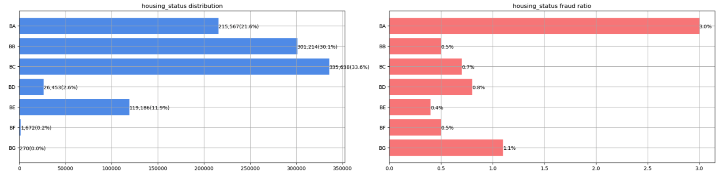
EDA
BC has the most number of fraud (~2500 records)
BA is the class with highest fraud rate with 3% among others

Slide 13
04- Data Preparation
Notes:
Note: Please after inserting your picture, “Right Click” on the picture and “Send it to Back” to get the “Gradient” effect.

Slide 14
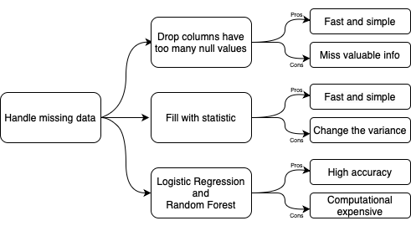
Handle Missing Data
Handle Missing Data Methods
In this usecase, outliers are not processed because:
Tree-based models are robust to outliers
Data is reasonable
Handle Outliers
One-hot Encoding
Label Encoding
Handle Categorical Features

Slide 15
05- Model
Notes:
Note: Please after inserting your picture, “Right Click” on the picture and “Send it to Back” to get the “Gradient” effect.

Slide 16
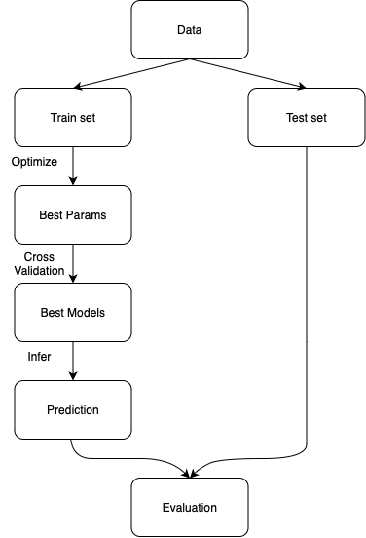
Model
Models:
LightGBM
XGBoost
Random Forest
Pros:
Can easily handle categorical features
Explainable
Robust to missing data
Best models among others
Model Flow Diagram

Slide 17
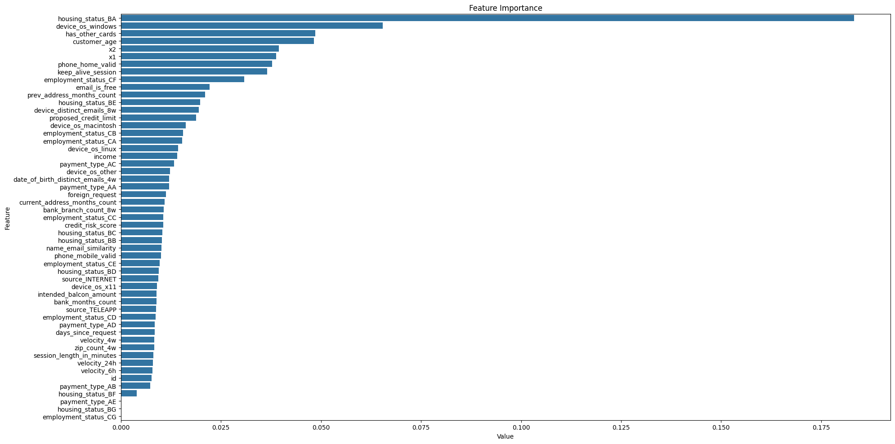
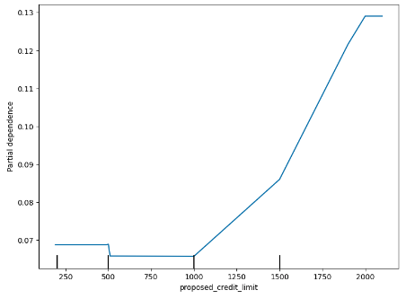
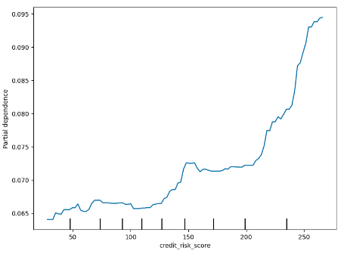
Evaluation
Metric: Recall @5% FPR
Reason: With imbalanced class,
accuracy is not an adequate metric
(as recommended in the paper)
However, the metric can be changed
due to different purposes.
E.g., maximize Recall for lower risk,
maximize Precision for higher risk.
Feature Importance
Model | Recall @5% FPR
LightGBM | 0.76
XGBoost | 0.77
Random Forest | 0.71
Evaluation table
Partial Dependence plots

Slide 18
06- Deployment
Notes:
Note: Please after inserting your picture, “Right Click” on the picture and “Send it to Back” to get the “Gradient” effect.

Slide 19
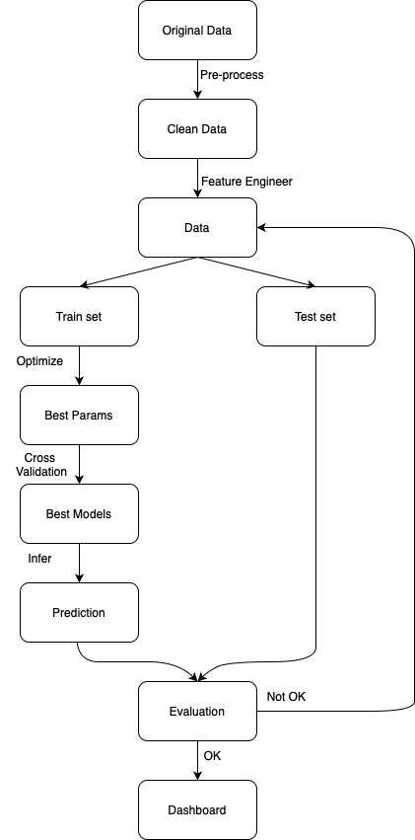
Workflow
The system can return result in real time
The model will be updated whenever there’s new data (daily, weekly, monthly, …)

Slide 20
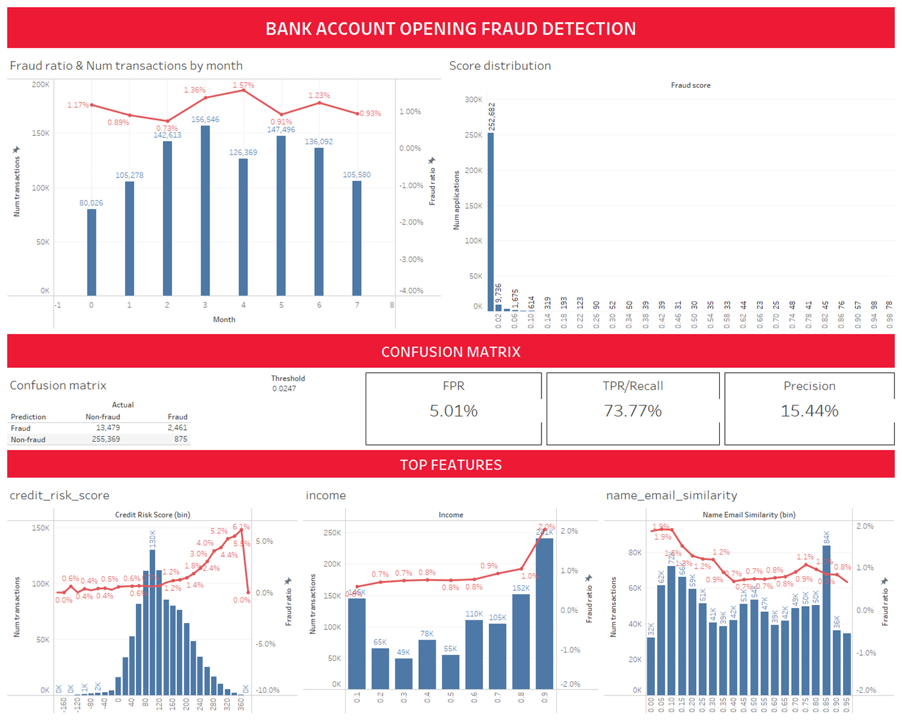
Dashboard

